Slide 1
Wine Quality prediction Analysis:
Tools used for Analzing Data : Python, Machine Leaning, Excel.

Slide 2
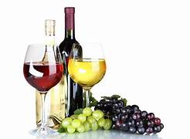
About Dataset :
The primary goal of this project is to build a predictive model that can accurately estimate wine quality based on its chemical
composition. The dataset used in this project is the Wine Quality dataset. It contains important chemical features such as: *Fixed
Acidity, Volatile Acidity, Citric Acid, Residual Sugar, Chlorides, Free Sulfur Dioxide, Total Sulfur Dioxide, Density pH, Sulphates,
Alcohol, Quality (target variable)

Slide 3
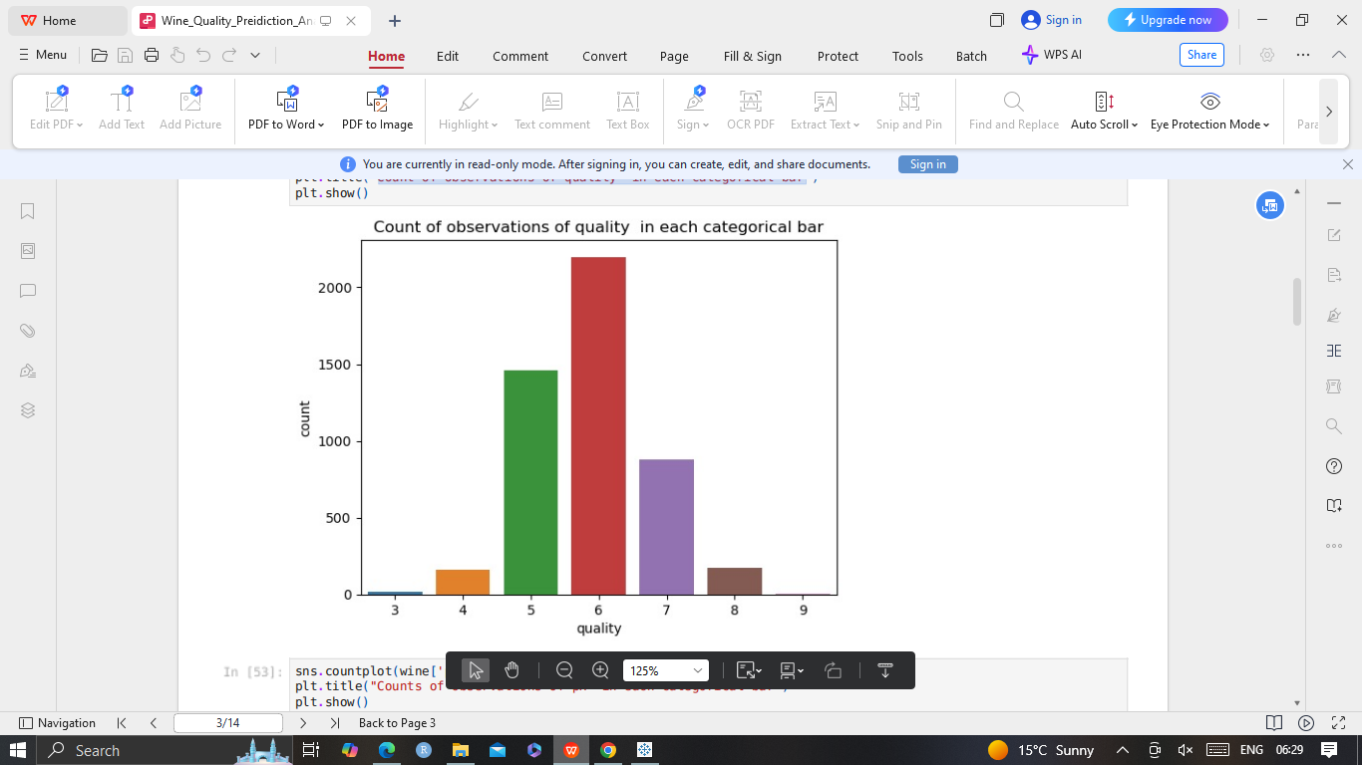
Count of observations of quality in each categorical bar

Slide 4
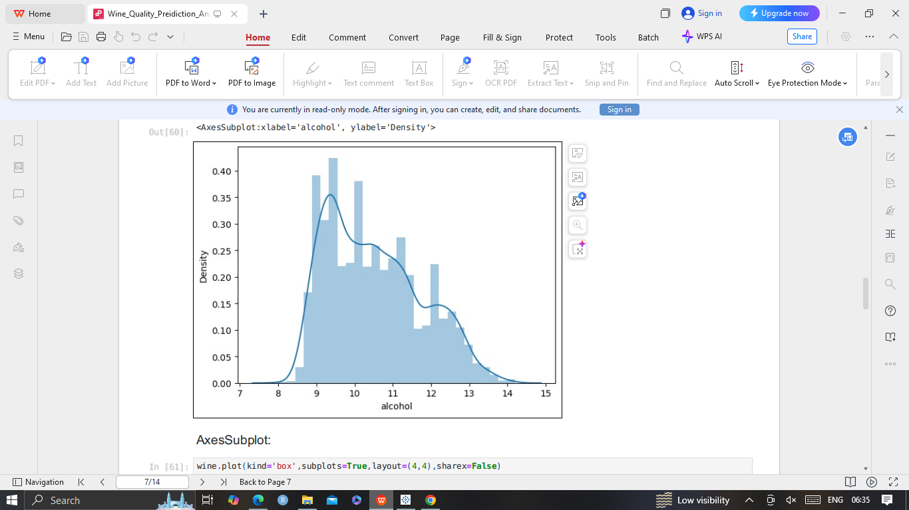
observations of density in alchohol
Density is used to measure the alcohol concentration in wines. During fermentation, the sugar in the juice is converted into ethanol with carbon dioxide as a waste gas. Monitoring the density during the process allows for optimal control of this conversion step for highest quality wines. Sweeter wines generally have higher densities.

Slide 5
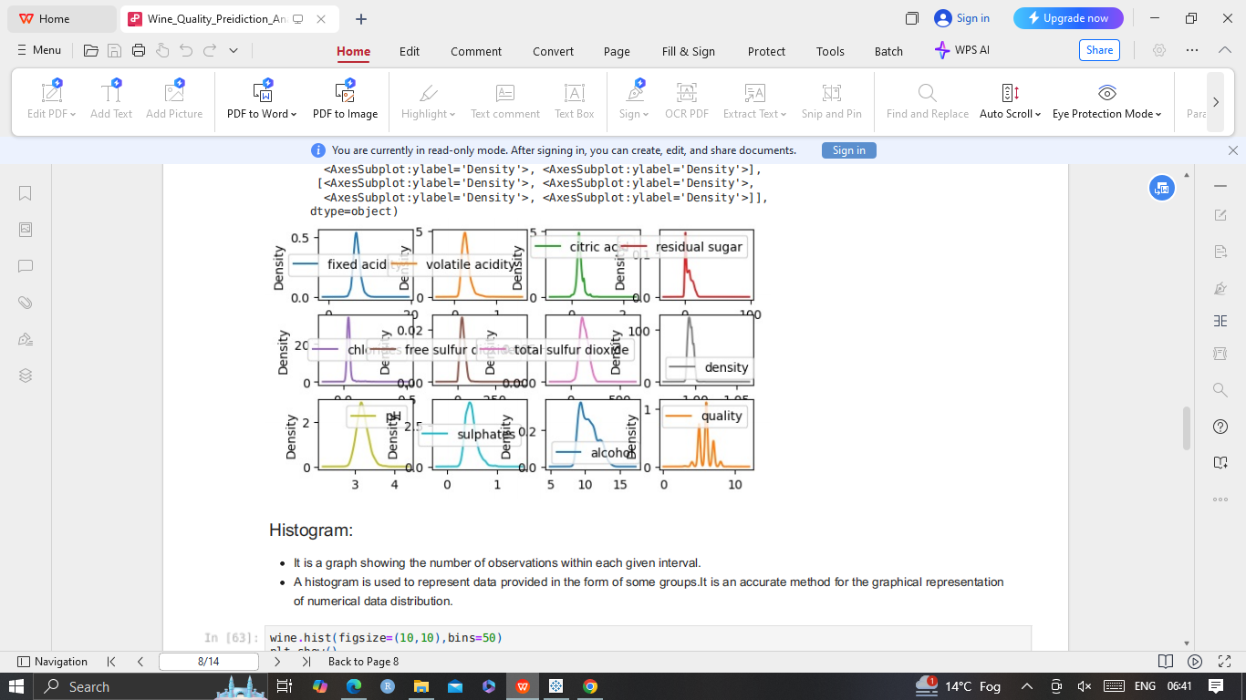
Observation of Density of wine:
Density vs Fixed acidity.
Density vs Volatile acidity
Density vs Citric acidity
Density vs Residual sugar
Density vs pH
Density vs Chloride
Density vs Sulphates
Density vs Sulfur dioxide
Density vs quality

Slide 6
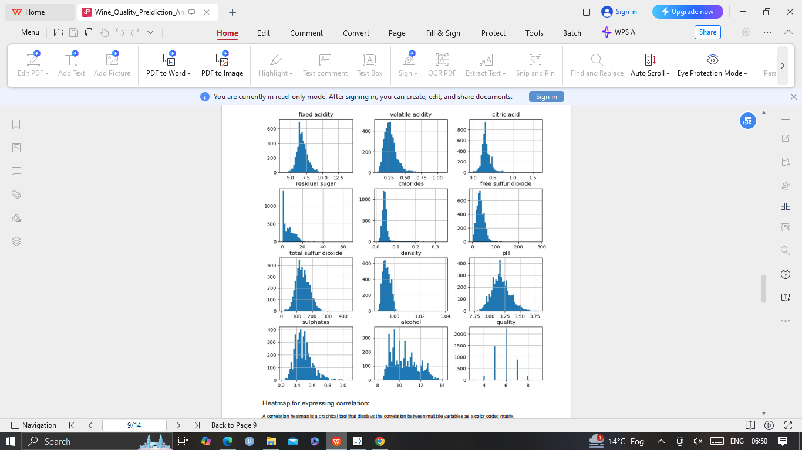
Histogram is a graph showing the number of observations within each given interval.
A histogram is used to represent data provided in the form of some groups. It is an accurate method for the graphical representation of numerical data distribution.

Slide 7
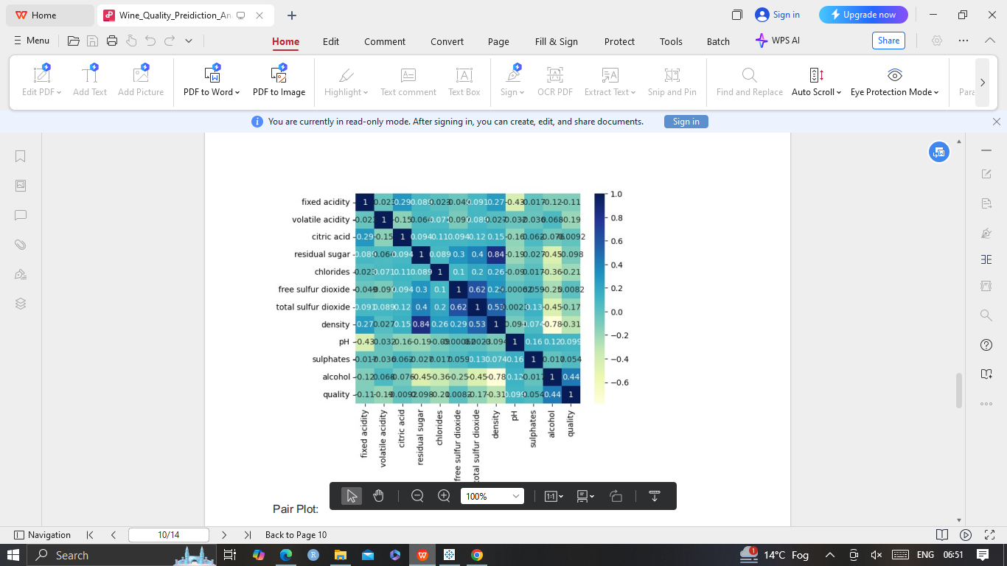
A correlation heatmap is a graphical tool that displays the correlation between multiple variables as a color coded matrix.

Slide 8
A correlation heatmap is a graphical tool that displays the correlation between multiple variables as a color coded matrix.

